Slide 1
AUTOMATIC CLEANING ROBOT
alphin a j
Aswin v babu
Shahabas aman
ShebiN
Ujjwal babu

Slide 2
INTRODUCTION
Mainly used for the removal of garbage and other waste materials from the public places such as parks , beaches etc,..
Uses vacuum cleaning mechanism for waste removal and disposal.
Sensors used for the detection and provide pathways’
Basic functions ; path planning ,obstacle avoidance,smart waste monitoring etc…

Slide 3
relevance
In the current situation ,India is facing various challenges in the environment by the improper waste collection,treatment,transport,disposal.
By making advancement in the present robotic vacuum cleaner ,it allows to be used in the public areas.
The robot allows proper cleaning of wastes without any human intervention.

Slide 4
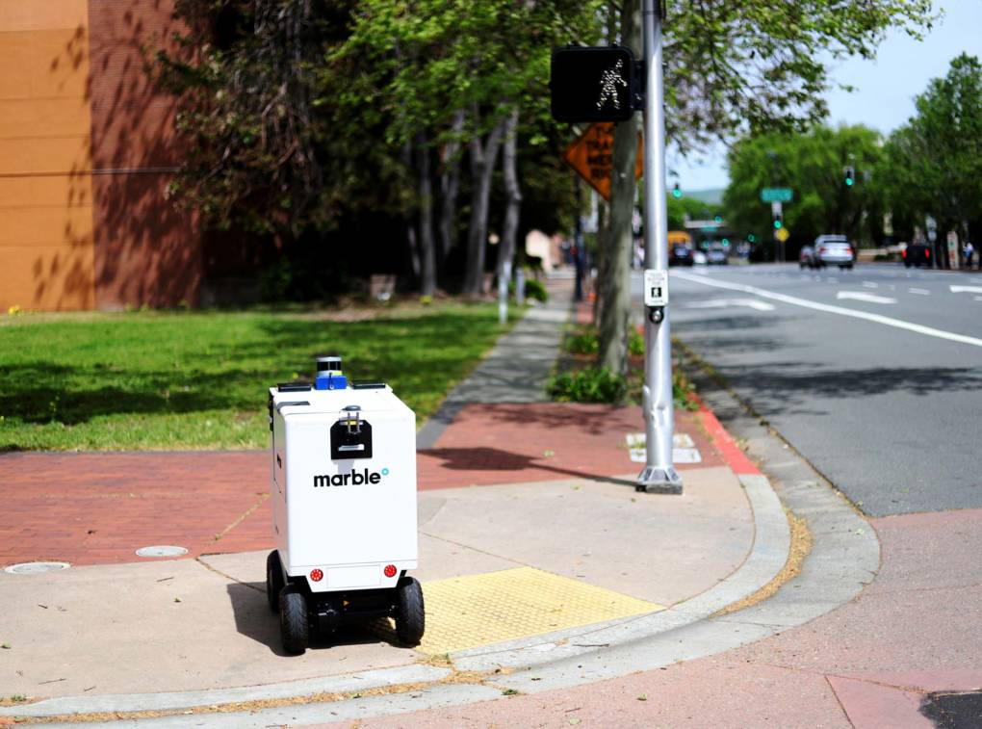
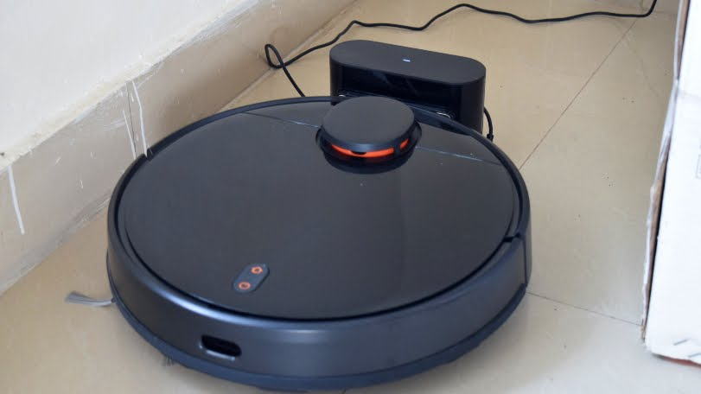
design

Slide 5
advantages
Waste disposal without any human intervention (remotely working mechanism ).
Easily controllable(through android application).
Efficient.

Slide 6
BLOCK DIAGRAM
RASPBERRY PI
STORAGE BIN
IP CAMERA MODULE
ULTRASONIC SENSORS
VACUUM CLEANER
LIDAR

Slide 7
Drawback
Continuous power supply.
Can’t differentiate waste materials accurately.
Waste storing capacity
Weight

Slide 8
when ?
Approximately 4-5 months.

Slide 9
THANK YOU….

Slide 10
Estimated cost
COMPONENTS | UNITS | PRICE
Vacuum Cleaner | 1 | 15000/-
Wheels | 4 | 300/-
Storage bin | 1 | 600/-
IP Camera | 1 | 2300/-
Lithium-Ion battery | 1 | 1500/-
Raspberry Pi | 1 | 5200/-
Ultrasonic sensor | 4 | 2100/-

